Slide 1
Magnetic dissipation in Poynting dominated outflows
Yuri Lyubarsky
Ben-Gurion University

Slide 2
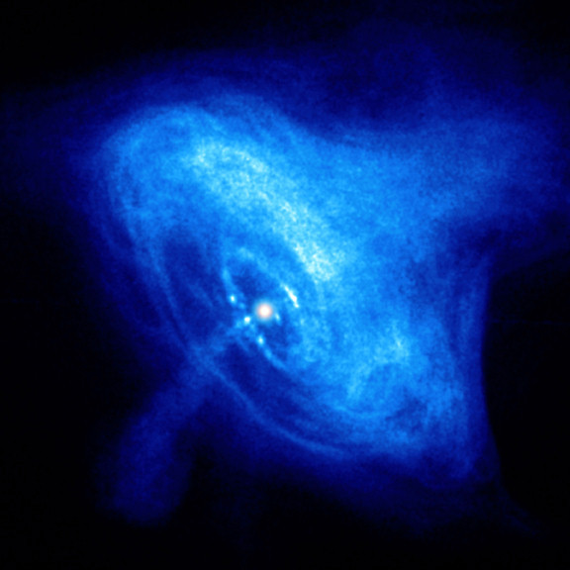
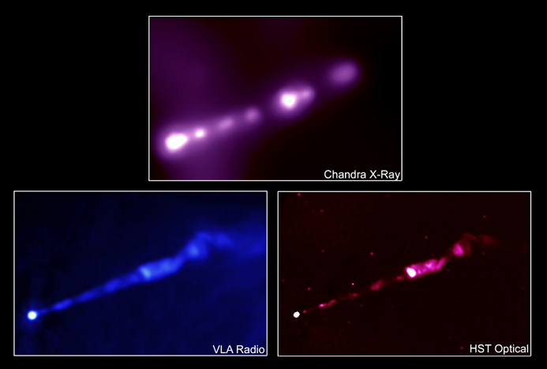
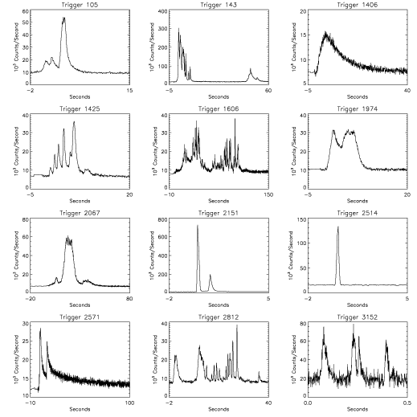
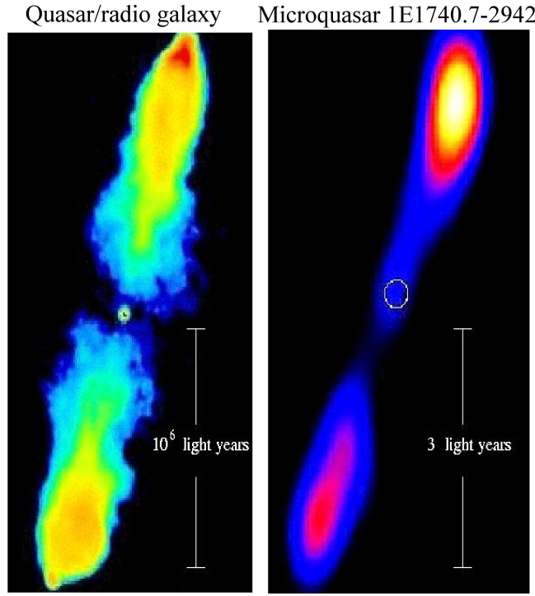
Ubiquity of relativistic outflows in astrophysics
M 87
Crab nebula in X-rays
Relativistic outflows are associated with:
quasars and AGNs
pulsars
GRBs
microquasars
GRB lightcurves

Slide 3
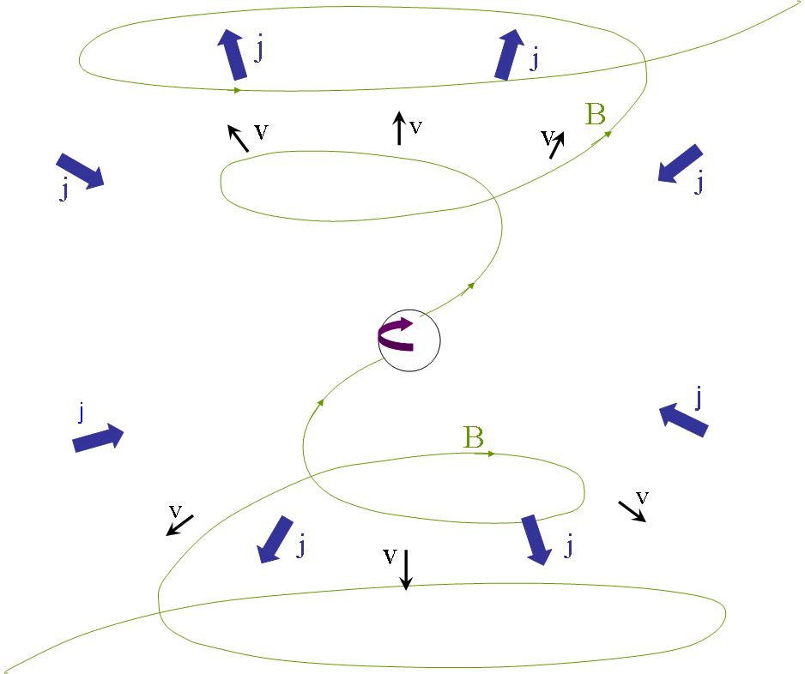
All relativistic astrophysical outflows may be connected by a common basic mechanism: acceleration by rotating, twisted magnetic fields
Rotation twists up field into toroidal component, slowing rotation

Slide 4
Relativistic flow, E_{kinetic}>> mc², is produced if the filed lines transfer the rotational energy to a low density plasma such that B²>>4πρc²
Rotational energy Poynting ?

Slide 5
kinetic energy
Ideal MHD
Poynting flux
thermal energy
radiation
Dissipation
non-thermal particles
What is the fate of the EM energy?
Where and how σ decreases from >>1 to <<1?

Slide 6
To summarize the dissipationless MHD acceleration
(Tchekhovskoy et al ‘08,’09; Komissarov et al ‘09; L ‘09,’10)
The flow could be accelerated till σ∼1 provided it is confined
by an external pressure, which decreases with distance but
not too fast. The condition for efficient acceleration $γθ≤1.$ The optimal pressure distribution: $p∝r^{−2}.$
The acceleration zone is very extended; γ_{max} is achieved at
$$r≥{\left(γ_{max}\right)}_{}^{2}r_{L}.$$
One has to ensure that the conditions for acceleration are fulfilled all along the way.
Transition to the matter dominated stage, σ∼0.1, could occur only at an unreasonably large scale.

Slide 7
AGNs: γ∼10 implies the size of the confining zone
r>100R_{g}~10¹⁶cm.
The absence of bulk-Comptonization spectral signatures in blazars implies that Lorentz factors >10 must be attained at least on the scale 1000R_{g} ~ 10¹⁷ cm (Sikora et al. ‘05).
But according to spectral fitting, jets are already matter dominated at ~1000 R_{g} (Ghisellini et al ‘10).
Violent dissipation somewhere around1000R_{g}?
GRBs: γ∼few 10²; minimal r>10¹¹ cm – marginally OK.
But achromatic breaks in the afterglow light curves and
statistics imply γΘ>>1, which is fulfilled only if the flow remains
Poynting dominated.
Magnetic dissipation is necessary.

Slide 8
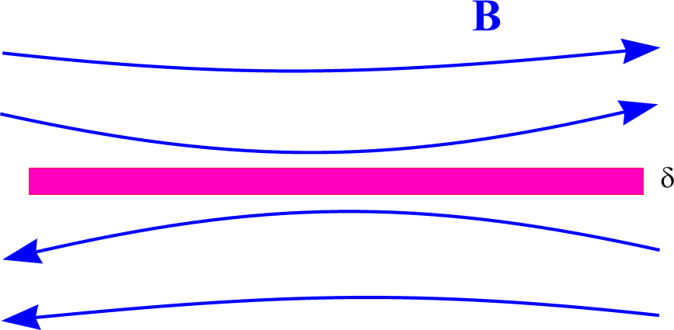
Beyond the ideal MHD:
magnetic dissipation in Poynting dominated outflows
The magnetic energy could be extracted via anomalous dissipation in narrow current sheets.
current sheet
How differently oriented magnetic field
lines could come close to each other?
Global MHD instabilities could disrupt the regular structure of the magnetic field thus liberating the magnetic energy.
Alternating magnetic field could be present in the flow from the very beginning (striped wind).

Slide 9
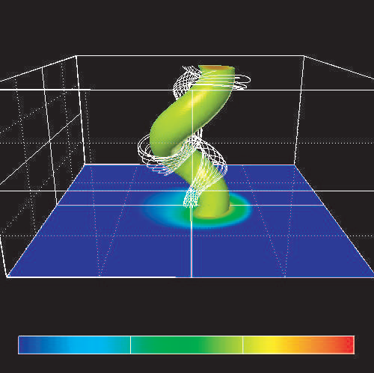
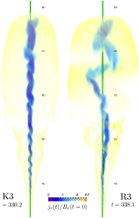
Global MHD instabilities
The most dangerous is the kink instability
(L ‘92, ‘99; Eichler ‘93; Spruit et al. ‘97; Begelman ‘98; Giannios&Spruit ‘06).
Mizuno et al ‘09
But: The necessary condition for the instability –
causal connection, γΘ<1. Not fulfilled in
GRBs; may be fulfilled in AGNs.
The growth rate is small in relativistic case
(Istomin&Pariev ‘94, ’96; L ‘99).
Some evidence for saturation of the
instability (McKinney&Blandford ‘09)
Moll et al ‘10

Slide 10
Striped wind
1. Pulsars
Wind from obliquely rotating
magnetosphere: variable fields are propagated as waves
The Poynting flux is maximal at the equator therefore most of the energy in the pulsar wind is transferred by the striped wind.

Slide 11
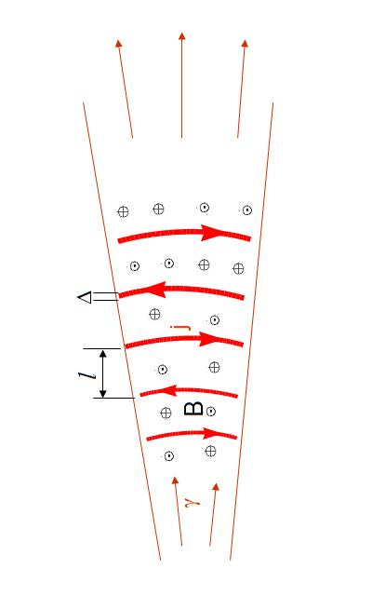
Striped wind
2. Jets
Could alternating magnetic field be presented in the flow from the very beginning?
Let alternating fields preexist in the jet
In an expanding flow, B becomes predominantly toroidal; current sheets are stretched. Local structure: plane current sheet separating oppositely directed fields.

Slide 12
Dissipation of alternating fields
current sheet
Δ
Condition for anomalous resistivity:
or equivalently:

Slide 13
Dissipation of alternating fields
1. Pulsars
Current starvation mechanism
(Usov ‘75; Michel ‘82, ‘94; Coroniti ‘90; L & Kirk ‘01; Kirk & Skjæraasen ‘03; Zenitani & Hoshino ‘07)
Eventually v_{current} ~ c
dissipation
The dissipation scale is about or larger than the termination shock radius. In the last case, the alternating fields annihilate at the termination shock (L ‘03; Petri & L ‘07; Sironi & Spitkovsky ‘11).

Slide 14
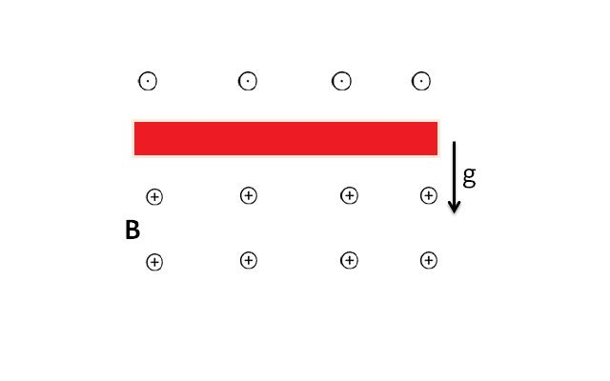
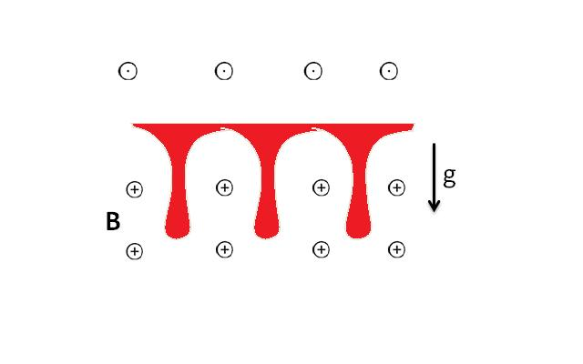
Dissipation of alternating fields
2. AGNs and GRBs
In AGNs and GRBs, r_{B}<<l~R_{g}. No conditions for anomalous dissipation.
Dissipation mechanism: Rayleigh-Taylor instability of currents sheets in accelerating flows (L ‘11)
$$g=c^{2}\frac{dγ}{dr}$$
In an accelerating relativistic flow
$$p=\frac{B^{2}}{8π}$$
Δ
j

Slide 15
acceleration
Rayleigh-Taylor instability
annihilation of oppositely directed fields
Due to dissipation, the magnetic field decreases faster than 1/r;
then the outward magnetic pressure gradient is not compensated by the hoop stress acceleration ( L & Kirk ‘01; Drenkhahn ‘02; Drenkhahn & Spruit ‘02)

Slide 16
Interplay between acceleration and dissipation;
a self-consistent picture
continuity
energy conservation
heat balance
$$Q=\frac{Δ}{τ}\frac{B^{2}}{8π}$$

Slide 17
Interplay between acceleration and dissipation;
a self-consistent picture (cont)
$$γ={\left(\frac{9γ_{max}r}{4ξ^{2}l}\right)}^{1/3}$$
Complete dissipation:$γ\sim γ_{max}; r_{diss}\sim {\left(ξγ_{max}\right)}^{2}l$
In accreting systems: $l\sim R_{g}$
AGNs
GRBs

Slide 18
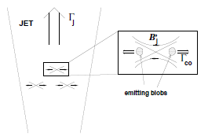
Advantage of the magnetic dissipation models
Dissipation easily provides large radiative efficiencies and strong variability necessary to fit observations
2. Gradual dissipation at the scale ~10¹¹-10¹³ cm could
account for the observed spectra of the prompt GRB
emission (Giannios & Spruit ‘07; Giannios ‘08).
3. Reconnection at high σ produces relativistic “jets in a jet”,
which could account for the fast TeV
variability of blazars (Giannios
et al ‘09,’10)

Slide 19
Conclusions
1. All relativistic astrophysical outflows may be magnetically driven. Then they are initially Poynting dominated.
2. Even though efficient transformation of the Poynting into
the kinetic energy is possible in principle, the conditions
are rather restrictive.
3. Dissipation (reconnection) is necessary in order to utilize
the EM energy of the outflow. This implies either global
MHD instability ( kink) or alternating fields preexisted in
the flow
4. Alternating fields are efficiently dissipated via the Rayleigh-
Taylor instability. The necessary effective gravity is self-
consistently maintained because magnetic dissipation results
in the acceleration of the flow.
5. Magnetic dissipation naturally provides high radiative efficiency and strong variability necessary to fit observations.

