Slide 1
Compressing Vector OLE
Elette Boyle | Geoffroy Couteau | Niv Gilboa
IDC | KIT | BGU
Yuval Ishai
Technion
To appear in CCS’18

Slide 2
Securely Compressing Correlations
Encryption
Sender
Receiver
One-Time Pad O
One-Time Pad O
G(k)=O
G(k)=O
Key k
Key k
General Correlation
Data u
Data w
G(a)=u
Relation R(u,w)
G(c)=w
Seed a
Seed c

Slide 3
Oblivious Linear-Function Evaluation (OLE)
Sender
Receiver
a,b∈F, F a field
x∈F
Input
Protocol
Output
ax+b∈F
Security requirement
No information on other party’s input beyond output.

Slide 4
OLE Example I
OLE follows from many assumptions
But all require public key crypto
Example – let E be additively homomorphic
For some function f (e.g. multiplication) and some integer m
f(E(a),E(b)) = E(a+b mod m), for any 0≤a,b<m
Public key, additively homomorphic cryptosystems include Paillier, GM, ElGamal, many others.

Slide 5
OLE Example II
Sender
Receiver
a,b∈F
x∈F
Input
E(x)
f(fª(E(x)),E(b)=E(ax+b)
Decrypt ax+b

Slide 6
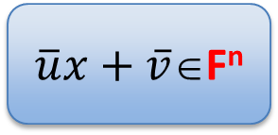
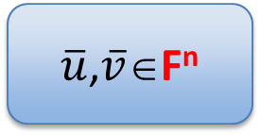
Vector OLE (VOLE)
Sender
Receiver
$\overline{u}$,$\overline{v}$∈F^{n}
x∈F
Input
Protocol
Output
$\overline{u}x+\overline{v}$∈F^{n}
Security requirement
No information on other party’s input beyond output.

Slide 7
Applications of VOLE
Secure computation
Arithmetic circuits- [Naor, Pinkas 06], [Ishai, Prabhakaran, Sahai09], [Dottling, Ghosh, Nielsen, Nilges, Trifiletti17]
Non-Interactive Zero Knowledge
Example: arguments in blockchain protocols

Slide 8
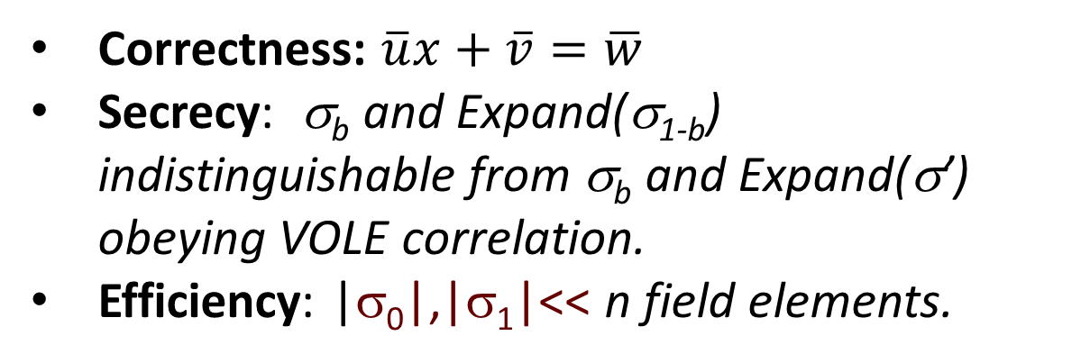
VOLE Generator
Setup(x,n)
Short seed σ₀
Short seed σ₁
Expand(σ₀)
Expand(σ₁)
$\overline{u,}\overline{v}$∈_{R}F^{n}
$\overline{w}$∈F^{n}
Correctness: $\overline{u}x+\overline{v}=\overline{w}$
Secrecy: σ_{b} and Expand(σ_{1-b}) indistinguishable from σ_{b} and Expand(σ’) obeying VOLE correlation.
Efficiency: |σ₀|,|σ₁|<< n field elements.

Slide 9
Background

Slide 10
Learning Parity
Concept
Learning Model
s∈F^{k}
a₁∈F^{k}, ⟨a₁,s⟩=Σa_{1i}s_{i}
a₂, ⟨a₂,s⟩
Uniform sample button
…
a_{m}, ⟨a_{m},s⟩
Goal: Learn s
Very easy! Gaussian Elimination for m=Ω(k)

Slide 11
Learning Parity with Noise (LPN)
Concept
Learning Model
s∈F^{k}
a₁, ⟨a₁,s⟩+e₁
a₂, ⟨a₂,s⟩+e₂
Pr[e_{i}=0]=1-ε, ε<0.5
Otherwise, e_{i} uniform in F\{0}
Uniform sample button
…
a_{m}, ⟨a_{m},s⟩+e_{m}
Goal: Learn s
Very Hard!

Slide 12
Attacks on LPN
Blum Kalai Wasserman [BKW00] – modified Gaussian elimination
Z₂ – O($2^{\frac{k}{\log{k}}}$) time and samples
General field F – O(2^{k}) time and samples
Gaussian attack
Choose subset of samples without noise and solve
[Esser, Kubler, May 17]
Time – O($\frac{1}{{(1−ε)}^{k}}$)
Samples – O(k²log k)
In our application – number of samples O(k).

Slide 13
Distributed Point Functions (DPF)
Point functions, f:{1,…,n}→G, for group G
F={f_{a,b}: f_{a,b}(a)=b, for x≠a f_{a,b}(x)=0}
DPF [GI14]
f₀
Eval
f₀(x)
f
= f (x)
+
f₁
f₁(x)
Gen
Secrecy: f_{i} hides f in a class F
Efficiency: |f_{i}| ~ |f|

Slide 14
DPF II
DPF schemes [GI14, BGI15, BGI16]
Based on one-way functions (e.g. Implementation on AES)
Share size 128 log n
Generation time – 4log n AES operations
Evaluation time – log n AES operations
Full domain evaluation (evaluation of every point) ~n AES operations

Slide 15
Multi-Point DPF (MP-DPF)
Let S⊆{1,…,n}, let y=(y₁,…,y_{|S|})
A multi-point function f_{yS}, is defined by
f_{yS}(i)=y_{i} for i∈S
f_{yS}(i)=0 for i∉S
MP-DPF implementation
Trivial by using DPF t times.
Improved performance by using batch codes.

Slide 16
VOLE Generator

Slide 17
Primal Generator (take I)
Setup (x,n)
Choose seed length parameter k
Choose random vectors
a₁ | … | a_{k}
$\overline{a}$, $\overline{b}$∈_{R}F^{k}
b₁ | … | b_{k}
seed σ₀=($\overline{a}$, $\overline{b}$)
seed σ₁=($\overline{c}$=$\overline{a}$x+$\overline{b}$)
Public random matrix M∈F^{k×n}
Expand(σ₀)
Expand(σ₁)
$\overline{u}$=$\overline{a}$M
$\overline{v}$=$\overline{b}$M
$\overline{w}$=$\overline{c}$M
u₁ | … | u_{n}
$\overline{u},\overline{v}$=
$\overline{w}$=
w₁ | … | w_{n}
v₁ | … | v_{n}

Slide 18
What’s Wrong with Take I?
Correctness
$\overline{u}$x+$\overline{v}$=($\overline{a}$x+$\overline{b}$)M=$\overline{c}$M=$\overline{w}$
Security
$\overline{c}$ is a “short representation” of ($\overline{u}$,$\overline{v}$).
⇒ Given $\overline{c}$, ($\overline{u}$,$\overline{v}$) is distinguishable from ($\overline{u}′$,$\overline{v}′$) such that $\overline{u}′$x+$\overline{v}′$=$\overline{w}′$.
⇒Scheme is insecure.
That’s good!
That’s bad!

Slide 19
Primal Generator- Setup
Setup (x,n)
Choose seed length parameter k
Choose random vectors $\overline{a}$, $\overline{b}$∈_{R}F^{k}
Compute $\overline{c}$=$\overline{a}$x+$\overline{b}$
Choose noise parameter ε, set t=εn
Choose random S⊆{1,…,n}, |S|=t
Choose random y=(y₁,…,y_{t})∈F
Run GEN(y,S) for MP-DPF and get keys k₀,k₁.
a₁ | … | a_{k}
c₁ | … | c_{k}
b₁ | … | b_{k}
u₁ | … | u_{n}
⋅x +
v₁ | … | v_{n}
=
w₁ | … | w_{n}
seed σ₀=($\overline{a}$, $\overline{b}$,S,y,k₀)
seed σ₁=($\overline{c}$,k₁)

Slide 20
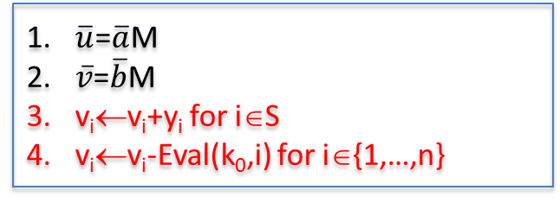
Primal Generator - Expand
Expand (σ₀=($\overline{a}$, $\overline{b}$,S,y,k₀))
Expand (σ₁=($\overline{c}$,k₁))
$\overline{u}$=$\overline{a}$M
$\overline{v}$=$\overline{b}$M
v_{i}←v_{i}+y_{i} for i∈S
v_{i}←v_{i}-Eval(k₀,i) for i∈{1,…,n}
$\overline{w}$=$\overline{c}$M
w_{i}←w_{i}-Eval(k₁,i) for i∈{1,…,n}
Theorem: Assuming that LPN with parameters (k,n,t/n) is hard and MP-DPF is secure then “Primal” is a secure VOLE generator
Note: The stretch of the generator |σ₀|→n is sub-quadratic.

Slide 21
Dual Generator
Primal generator based on Code-Generating matrix M∈F^{k×n}
Consider Dual/Parity check matrix P∈F^{n×n’}
Setup (x,n)
Choose parameter k
Choose random S⊆{1,…,n}, |S|=k
Choose random y=(y₁,…,y_{k})∈F
Run GEN(xy,S) for MP-DPF and get keys k₀,k₁.
Set σ₀=(y,S,k₀) and σ₁=(k₁)

Slide 22
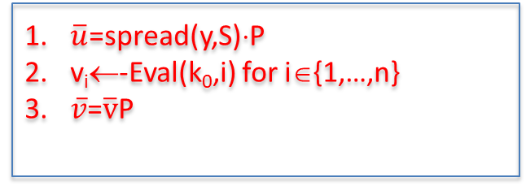
Dual Generator II
Expand (σ₀=(S,y,k₀))
Expand (σ₁=k₁)
$\overline{u}$=spread(y,S)⋅P
v_{i}←-Eval(k₀,i) for i∈{1,…,n}
$\overline{v}$=$\overline{v}$P
w_{i}←Eval(k₁,i) for i∈{1,…,n}
$\overline{w}$=$\overline{w}$P
Theorem: Assuming that LPN with parameters (k,n,t/n) is hard and MP-DPF is secure then “Dual” is a secure VOLE generator
Note: The stretch of the generator |σ₀|→n is any arbitrary polynomial.

Slide 23
Performance

Slide 24
Thank You!

